Slide 1
Anomaly Detection Using ML and DL Techniques

Slide 2
Agenda
Anomaly Detection Overview
Types of Learning
Anomaly Detection in Time Series Data
ML Techniques:
Random Forest/Decision Trees
Isolation Forest
Time Series Forecasting using Prophet
Demo/Code Overview
Deep Learning Techniques:
Auto Encoders
LSTM (Long Short-Term Memory)
Demo/Code Overview

Slide 3
Anomaly Detection:
Anomaly detection is the process of identifying unexpected items or events in data sets, which differ from the norm. And anomaly detection is often applied on unlabelled data which is known as unsupervised anomaly detection. Anomaly detection has two basic assumptions:
Anomalies only occur very rarely in the data.
Their features differ from the normal instances significantly.

Slide 4
Types of learning:
Supervised Learning: Labelled
Unsupervised Learning: Unlabelled
Reinforcement Learning: Feedback/Reward Model

Slide 5
Anomaly Detection in Time Series:
Time series are everywhere! In user behaviour on a website, or stock prices of a Fortune 500 company, or any other time-related example. Time series data is evident in every industry in some shape or form.
Naturally, it’s also one of the most researched types of data. As a rule of thumb, you could say time series is a type of data that’s sampled based on some kind of time-related dimension like years, months, or seconds.

Slide 6
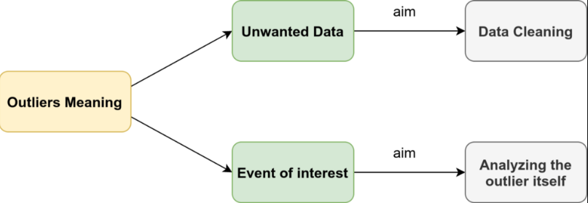
What are anomalies/outliers and types of anomalies in time-series data?

Slide 7
Anomaly detection techniques in time series data
Deep Learning:
MLP (Multi-Layer Perceptron/Feed Forward NN)
CNN (Convolutional Neural Network)
RNN (Recurrent Neural Networks)
LSTM (Long Short Term Memory
Autoencoders
Machine Learning:
Classification and Regression Trees (CART)
Random Forest/Decision Trees: Supervised Learning (Labelled Data)
Isolation Forest: Unsupervised Learning
Time Series Forecasting (Prophet)
Notes:
RNN works on the principle of saving the output of a particular layer and feeding this back to the input in order to predict the output of the layer.
RNN were created because there were a few issues in the feed-forward neural network:
Cannot handle sequential data
Considers only the current input
Cannot memorize previous inputs
Image Captioning, Time Series Prediction, Natural Language Processing, Machine Translation

Slide 8
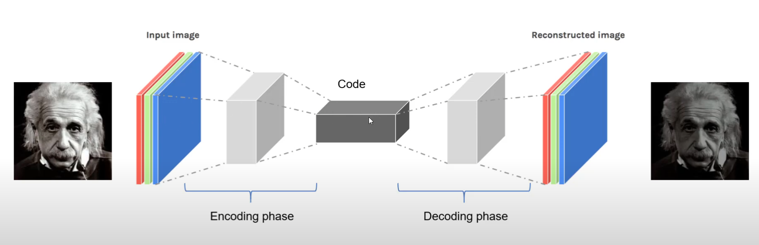
Vanilla Autoencoder:

Slide 9
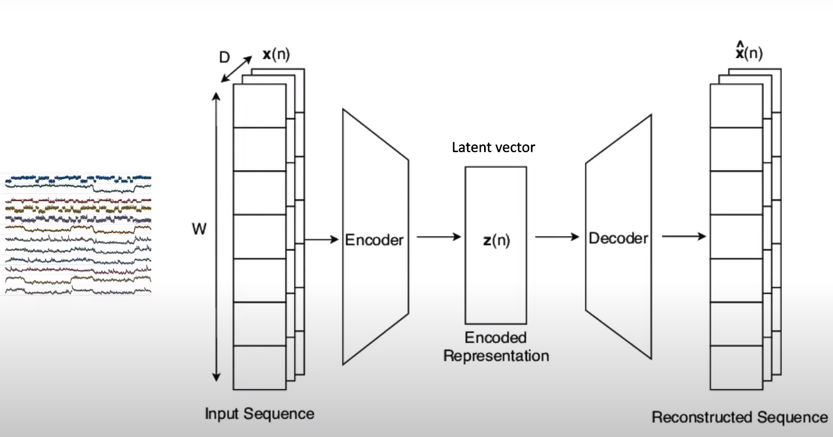
LSTM Autoencoder:
Notes:
RNN’s remembers the past. My decision to pick a cuisine to eat tonight depends on what I ate yesterday but not on the weekday. They make use of sequential information.
LSTM is a special kind of RNN which remembers information for long periods of time.
RNN: The sky is _____ (Answer = Blue)
This is the 30th day of wildfires in san fransisco bay area. There is smoke everywhere, its snowing ash and the sky is _________ (Red)
A lot of previous answers are required to get the answer right and RNN fails in that case.

Slide 10
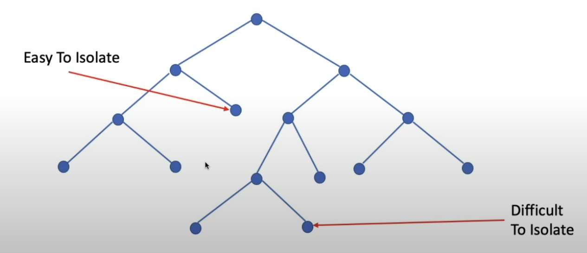
Isolation Forest:
Notes:
Model builds a random forest in which each decision tree is built randomly
Set of if else rules which is a set of recursive partition algorithm to repeatedly divide and sub divide the data to make it as homogeneous as possible.
Uses a random forest formed out of decision trees to actually to that.
Picks a random threshold value and splits the data set into two and as the dataset gets gradually chopped into sub samples.
Eventually each observation gets isolated from all of the others and when the algorithm starts chopping the data down then the anomalies will start getting isolated faster.
When applying an IsolationForest model, we set contamination = outliers_fraction, that is telling the model what proportion of outliers are present in the data. This is a trial/error metric.

Slide 11
Thank You

Slide 12
Notes:
The Sequential model is a linear stack of layers. You can create a Sequential model by passing a list of layer instances to the constructor

